Slide 1
Bank Term Deposit Marketing
By: Gaurav Gore

Slide 2
Business Problem:
Reducing marketing resources by identifying customers who would subscribe to term deposit and thereby direct marketing efforts to them.

Slide 3
Introduction
Bank marketing is known for its nature of developing a unique brand image, which is treated as the capital reputation of the financial academy. It is very important for a bank to develop good relationship with valued customers accompanied by innovative ideas which can be used as measures to meet their requirements.
Customers expect quality services and returns. There are good chances that the quality factor will be the sole determinant of successful banking corporations. Therefore, Indian banks need to acknowledge the imperative of proactive Bank Marketing and Customer Relationship Management and also take systematic steps in this direction.

Slide 4
What is a Term Deposit?
A time deposit or term deposit is a deposit in a financial institution with a specific maturity date or a period to maturity, commonly referred to as its "term".
A term deposit is a fixed-term investment that includes the deposit of money into an account at a financial institution. Term deposit investments usually carry short-term maturities ranging from one month to a few years and will have varying levels of required minimum deposits.
The investor must understand when buying a term deposit that they can withdraw their funds only after the term ends. In some cases, the account holder may allow the investor early termination or withdrawal if they give several days notification. Also, there will be a penalty assessed for early termination.

Slide 5
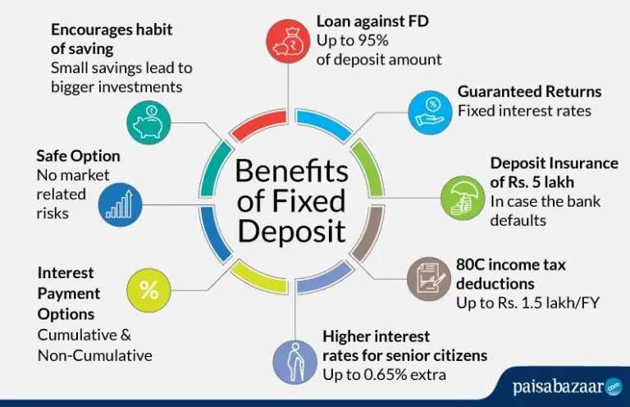

Slide 6
Approach
Algorithms used – Random Forest
Accuracy – 83.6%
Future Improvement – We can apply more algorithms including deep learning and more boosting methods such as xgboost, catboost, gradient boostings,etc.

Slide 7
Thank you

